Slide 1

Undecidability II
Sections 21.4 - 21.7

Slide 2
Is There a Pattern?
  ● Does L contain some particular string w?
  ● Does L contain ε?
  ● Does L contain any strings at all?
  ● Does L contain all strings over some alphabet Σ?
  ● A = {<M, w> : TM M accepts w}.
  ● A_{ε} = {<M> : TM M accepts ε}.
  ● A_{ANY} = {<M> : there exists at least one string that
  TM M accepts}.
  ● A_{ALL} = {<M> : TM M accepts all inputs}.

Slide 3
Rice’s Theorem
  Any nontrivial property of the SD languages is undecidable.
  or
  Any language that can be described as:
  {<M>: P(L(M)) = True}
  for any nontrivial property P, is not in D.
  A nontrivial property is one that is not simply:
  True for all languages, or
  False for all languages.

Slide 4
Applying Rice’s Theorem
To use Rice’s Theorem to show that a language L is not in D we must:
● Specify property P.
● Show that the domain of P is the SD languages.
● Show that P is nontrivial:
● P is true of at least one language
● P is false of at least one language

Slide 5
Examples
1. {<M> : L(M) contains only even length strings}.
2. {<M> : L(M) contains an odd number of strings}.
3. {<M> : L(M) contains all strings that start with a}.
4. {<M> : L(M) is infinite}.
5. {<M> : L(M) is regular}.
6. {<M> : M contains an even number of states}.
7. {<M> : M has an odd number of symbols in its tape
alphabet}.
8. {<M> : M accepts ε within 100 steps}.
9. {<M>: M accepts ε}.
10. {<M_{a}, M_{b}> : L(M_{a}) = L(M_{b})}.

Slide 6
Proof of Rice’s Theorem
Proof: Let P be any nontrivial property of the SD languages.
H = {<M, w> : TM M halts on input string w}
R
(?Oracle) L₂ = {<M> : P(L(M)) = T}
Either P(∅) = T or P(∅) = F.
Assume it is P(∅) = F (a matching proof exists if it is T).
Since P is nontrivial, there is some SD language L_{T} such that P(L_{T}) = T. Let M_{T} be some Turing machine that semidecides L_{T}.

Slide 7
Proof (cont’d)
R(<M, w>) =
1. Construct <M#>, so M#(x) operates as follows:
  1.1. Copy its input x to another track for later.
  1.2. Erase the tape.
  1.3. Write w on the tape.
  1.4. Run M on w.
  1.5 Put x back on the tape and run M_{T} on x.
2. Return <M#>.
C = Oracle(R(<M, w>)) decides H:
<M, w> ∈ H: M halts on w. M# makes it to 1.5.
So it is equivalent to M_{T}.
L(M#) = L(M_{T}) and so P(L(M#)) = P(L(M_{T})) = T.
Oracle decides P. Oracle accepts.
<M, w> ∉ H: M does not halt on w. M# gets stuck in 1.4.
So it accepts nothing.
L(M#) = ∅ and so P(L(M#)) = P(∅) = F.
Oracle decides P. Oracle rejects.

Slide 8
Given a TM M, is L(M) Regular?
The problem: Is L(M) regular?
The language: Is {<M> : L(M) is regular} in D?
Rice’s Theorem says no:
● P = True if L is regular and False otherwise.
● The domain of P is the set of SD languages since it is the set of languages accepted by some TM.
● P is nontrivial:
  ♦ P(a*) = True.
  ♦ P(A^{n}B^{n}) = False.

Slide 9
Reduction from H
R(<M, w>) =
1. Construct the description <M#>, where M#(x) operates as follows:
  1.1. Save x for later.
  1.2. Erase the tape.
  1.3. Write w on the tape.
  1.4. Run M on w.
  1.5. Put x back on the tape.
  1.6. If x ∈ A^{n}B^{n} then accept, else reject.
  2. Return <M#>.
  If Oracle decides L₂, then C = ¬Oracle(R(<M, w>)) decides H:
  ● <M, w> ∈ H: M# makes it to step 1.5. Then it accepts x iff
  x ∈ A^{n}B^{n}. So M# accepts A^{n}B^{n}, which is not regular.
  Oracle rejects. C accepts.
  ● <M, w> ∉ H: M does not halt on w. M# gets stuck in step 1.4.
  It accepts nothing. L(M#) = ∅, which is regular.
  Oracle accepts. C rejects.
  But no machine to decide H can exist, so neither does Oracle.

Slide 10
Without Flipping
R(<M, w>) =
1. Construct the description <M#>, where M#(x) operates as follows:
  1.1. If x ∈ A^{n}B^{n} then accept, else:
  1.2. Erase the tape.
  1.3. Write w on the tape.
  1.4. Run M on w.
  1.5. Accept
2. Return <M#>.
If Oracle exists, C = Oracle(R(<M, w>)) decides H:
● C is correct: M# immediately accepts all strings A^{n}B^{n}:
  ● <M, w> ∈ H: M# accepts everything else in step 1.5. So
  L(M#) = Σ*, which is regular. Oracle accepts.
  ● <M, w> ∉ H: M# gets stuck in step 1.4, so it accepts nothing
  else. L(M#) = A^{n}B^{n}, which is not regular. Oracle rejects.
  But no machine to decide H can exist, so neither does Oracle.

Slide 11
Any Nonregular Language Works
R(<M, w>) =
1. Construct the description <M#>, where M#(x) operates as follows:
  1.1. If x ∈ WW then accept, else:
  1.2. Erase the tape.
  1.3. Write w on the tape.
  1.4. Run M on w.
  1.5. Accept
2. Return <M#>.
If Oracle exists, C = Oracle(R(<M, w>)) decides H:
● C is correct: M# immediately accepts all strings WW:
  ● <M, w> ∈ H: M# accepts everything else in step 1.5. So
  L(M#) = Σ*, which is regular. Oracle accepts.
  ● <M, w> ∉ H: M# gets stuck in step 1.4, so it accepts nothing
  else. L(M#) = WW, which is not regular. Oracle rejects.
  But no machine to decide H can exist, so neither does Oracle.

Slide 12
Is L(M) Context-free?
How about: L₃ = {<M> : L(M) is context-free}?
R(<M, w>) =
1. Construct the description <M#>, where M#(x) operates as follows:
  1.1. If x ∈ A^{n}B^{n}C^{n} then accept, else:
  1.2. Erase the tape.
  1.3. Write w on the tape.
  1.4. Run M on w.
  1.5. Accept
2. Return <M#>.

Slide 13
Practical Implications on Programs
1. Does P, when running on x, halt?
2. Might P get into an infinite loop on some input?
3. Does P, when running on x, ever output a 0? Or anything at
all?
4. Are P₁ and P₂ equivalent?
5. Does P, when running on x, ever assign a value to n?
6. Does P ever reach a coding segment S on any input (in other words, can we chop it out?
7. Does P reach S on every input (in other words, can we
guarantee that S happens)?

Slide 14
Turing Machine Questions Can be Reduced to Program Questions
EqPrograms =
{<P_{a}, P_{b}> : P_{a} and P_{b} are PL programs and L(P_{a}) = L(P_{b})}.
We can build, in any programming language PL, SimUM:
  that is a PL program
  that implements the Universal TM U and so can simulate an arbitrary TM.

Slide 15
TM Questions and Program Questions
EqPrograms = {<P_{a}, P_{b}> : P_{a} and P_{b} are PL programs and L(P_{a}) = L(P_{b})}.
Theorem: EqPrograms is not in D.
Proof: Reduction from EqTMs = {<M_{a}, M_{b}> : L(M_{a}) = L(M_{b})}.
R(<M_{a}, M_{b}>) =
1. Build P₁, a PL program that, on w, returns SimUM(M_{a}, w).
2. Build P₂, a PL program that, on w, returns SimUM(M_{b}, w).
3. Return <P₁, P₂>.
If Oracle exists and decides EqPrograms, then C = Oracle(R(<M_{a}, M_{b}>))
decides EqTMs. C is correct. L(P₁) = L(M_{a}) and L(P₂) = L(M_{b}). So:
● <M_{a}, M_{b}> ∈ EqTMs: L(M_{a}) = L(M_{b}). So L(P₁) = L(P₂). Oracle(<P₁, P₂>)
accepts.
● <M_{a}, M_{b}> ∉ EqTMs: L(M_{a}) ≠ L(M_{b}). So L(P₁) ≠ L(P₂). Oracle(<P₁, P₂>)
rejects.
But no machine to decide EqTMs can exist, so neither does Oracle.

Slide 16
{<M, q> : M reaches q on some input}
H_{ANY} = {<M> : there exists some string on which TM M halts}
R
(?Oracle) L₂ = {<M, q> : M reaches q on some input}
R(<M>) =
1. Build <M#> so that M# is identical to M except that, if M has a transition
((q₁, c₁), (q₂, c₂, d)) and q₂ is a halting state other than h, replace that
transition with:
((q₁, c₁), (h, c₂, d)).
2. Return <M#, h>.
If Oracle exists, then C = Oracle(R(<M>)) decides H_{ANY}:
● R can be implemented as a Turing machine.
● C is correct: M# will reach the halting state h iff M would reach some
halting state. So:
● <M> ∈ H_{ANY}: There is some string on which M halts. So there is some
string on which M# reaches state h. Oracle accepts.
● <M> ∉ H_{ANY}: There is no string on which M halts. So there is no string
on which M# reaches state h. Oracle rejects.
But no machine to decide H_{ANY} can exist, so neither does Oracle.

Slide 17

How many Turing machines does it take to change a light bulb?
One.
How can you tell whether your Turing machine is the one?
You can’t.
- Tim Nodine

Slide 18
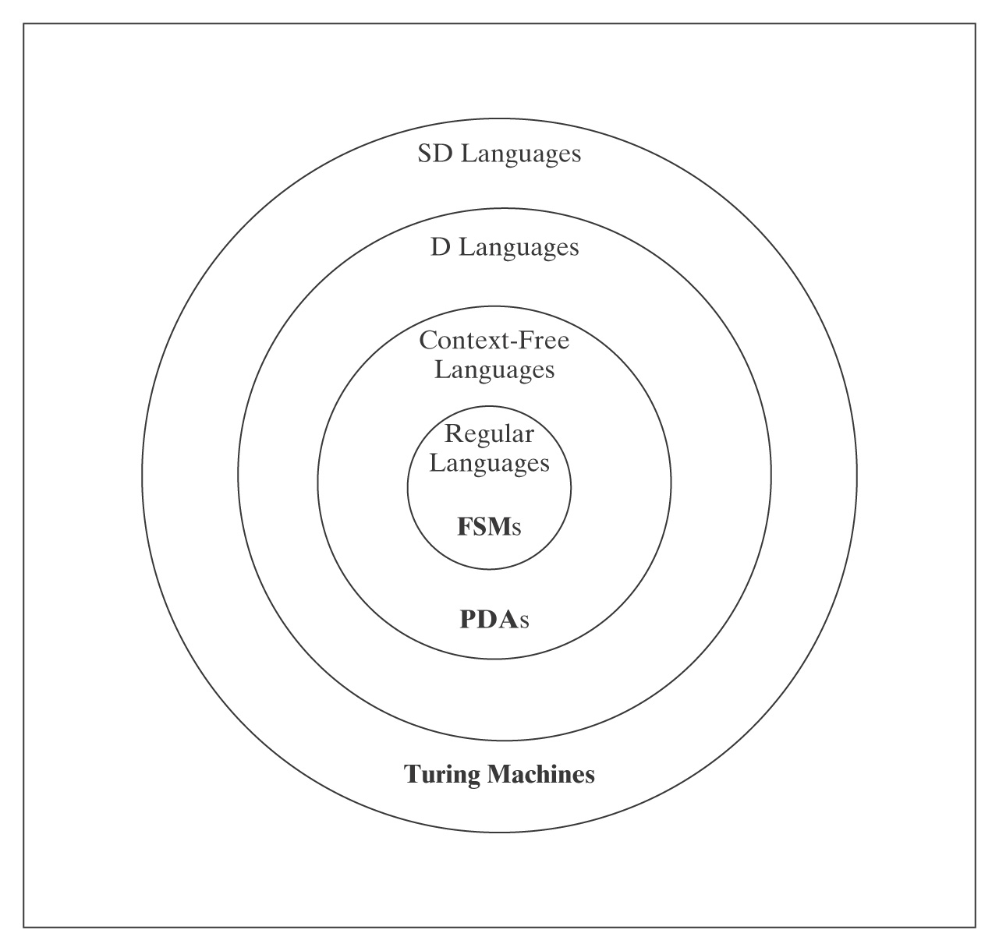
Non-SD Languages
There is an uncountable number of non-SD languages, but only a
countably infinite number of TM’s (hence SD languages).
∴The class of non-SD languages is much bigger than that of SD languages!

Slide 19
Non-SD Languages
Intuition: Non-SD languages usually involve either infinite
search or knowing a TM will go to an infinite loop.
Examples:
¬H = {<M, w> : TM M does not halt on w}.
{<M> : L(M) = Σ*}.
{<M> : TM M halts on nothing}.
Proving a language is not in SD:
L is the complement of an SD\D Language.
  Recall that L,¬L ∈ SD => L,¬L ∈ D
Reduction from a known non-SD language

Slide 20
Complement is in SD/D
Theorem: H_{¬ANY} = {<M> : there does not exist any string on which TM M halts} is not in SD.
Proof: ¬H_{¬ANY} = H_{ANY} =
{<M> : there exists at least one string on which TM M halts}.
We already know:
● ¬H_{¬ANY} is in SD.
● ¬H_{¬ANY} is not in D.
So H_{¬ANY} is not in SD because, if it were, then H_{ANY} would be in D but it isn’t.

Slide 21
Using Reduction
Theorem: If there is a reduction R from L₁ to L₂ and L₁ is
not SD, then L₂ is not SD.
So, we must:
Choose a language L₁ that is known not to be in SD.
Hypothesize the existence of a semideciding TM Oracle.
Note: R may not swap accept for loop!

Slide 22
Using Reduction for H_{¬ANY}
¬H = {<M, w> : TM M does not halt on input string w}
R
(?Oracle) H_{¬ANY} = {<M> : there does not exist a string
on which TM M halts}
R(<M, w>) =
1. Construct the description <M#> of M#(x):
  1.1. Erase the tape.
  1.2. Write w on the tape.
  1.3. Run M on w.
2. Return <M#>.

Slide 23
Using Reduction for H_{¬ANY}
R(<M, w>) =
1. Construct the description <M#> of M#(x):
  1.1. Erase the tape.
  1.2. Write w on the tape.
  1.3. Run M on w.
2. Return <M#>.
If Oracle exists, then C = Oracle(R(<M, w>)) semidecides ¬H:
● C is correct: M# ignores its input. It halts on everything or nothing, depending on whether M halts on w. So:
● <M, w> ∈ ¬H: M does not halt on w, so M# halts on
nothing. Oracle accepts.
● <M, w> ∉ ¬H: M halts on w, so M# halts on everything.
Oracle does not accept.
But no machine to semidecide ¬H can exist, so neither does Oracle.

Slide 24
A_{anbn} = {<M> : L(M) = A^{n}B^{n}}
A_{anbn} contains strings that look like:
(q00,a00,q01,a00,→),
(q00,a01,q00,a10,→),
(q00,a10,q01,a01,←),
(q00,a11,q01,a10,←),
(q01,a00,q00,a01,→),
(q01,a01,q01,a10,→),
(q01,a10,q01,a11,←),
(q01,a11,q11,a01,←)
It does not contain strings like aaabbb.
But A^{n}B^{n} does.

Slide 25
A_{anbn} = {<M> : L(M) = A^{n}B^{n}} is not SD
¬H = {<M, w> : TM M does not halt on w}
R
(?Oracle) A_{anbn} = {<M> : L(M) = A^{n}B^{n}}
R(<M, w>) =
1. Construct the description <M#>, where M#(x) operates as follows:
  1.1 Copy the input x to another track for later.
  1.2. Erase the tape.
  1.3. Write w on the tape.
  1.4. Run M on w.
  1.5. Put x back on the tape.
  1.6. If x ∈ A^{n}B^{n} then accept, else loop.
2. Return <M#>.
If Oracle exists, C = Oracle(R(<M, w>)) semidecides ¬H: !?!?
Notes:
If <M, w> is in ¬H, L(M#) = ∅. If <M, w> is not in ¬H, L(M#) is A^{n}B^{n}. So Oracle gets it backwards.

Slide 26
A_{anbn} = {<M> : L(M) = A^{n}B^{n}} is not SD
R(<M, w>) reduces ¬H to A_{anbn}:
1. Construct the description <M#>:
  1.1. If x ∈ A^{n}B^{n} then accept. Else:
  1.2. Erase the tape.
  1.3. Write w on the tape.
  1.4. Run M on w.
  1.5. Accept.
  2. Return <M#>.
If Oracle exists, then C = Oracle(R(<M, w>)) semidecides ¬H:
M# immediately accepts all strings in A^{n}B^{n}. If M does not halt on
w, those are the only strings M# accepts. If M halts on w,
M# accepts everything:
● <M, w> ∈ ¬H: M does not halt on w, so M# accepts strings in
A^{n}B^{n} in step 1.1. Then it gets stuck in step 1.4, so it accepts
nothing else. It is an A^{n}B^{n} acceptor. Oracle accepts.
● <M, w> ∉ ¬H: M halts on w, so M# accepts everything. Oracle does not accept.
But no machine to semidecide ¬H can exist, so neither does Oracle.

Slide 27
H_{ALL} = {<M> : TM halts on Σ*}
¬H = {<M, w> : TM M does not halt on w}
R
(?Oracle) H_{ALL} = {<M> : TM halts on Σ*}
Reduction Attempt 1: R(<M, w>) =
1. Construct the description <M#>, where M#(x) operates as follows:
  1.1. Erase the tape.
  1.2. Write w on the tape.
  1.3. Run M on w.
2. Return <M#>.
If Oracle exists, C = Oracle(R(<M, w>)) semidecides ¬H:
● <M, w> ∈ ¬H: M does not halt on w, so M# gets stuck in step 1.3
and halts on nothing. Oracle does not accept.
● <M, w> ∉ ¬H: M halts on w, so M# halts on everything. Oracle
accepts.
Problem: cannot flip the answer.

Slide 28
H_{ALL} = {<M> : TM halts on Σ*}
R(<M, w>) reduces ¬H to H_{ALL}:
1. Construct the description <M#>, where M#(x) operates as follows:
  1.1. Copy the input x to another track for later.
  1.2. Erase the tape.
  1.3. Write w on the tape.
  1.4. Run M on w for |x| steps or until M naturally halts.
  1.5. If M naturally halted, then loop.
  1.6. Else halt.
2. Return <M#>.
If Oracle exists, C = Oracle(R(<M, w>)) semidecides ¬H:
● <M, w> ∈ ¬H: No matter how long x is, M will not halt in |x|
steps. So, for all inputs x, M# makes it to step 1.6. So it
halts on everything. Oracle accepts.
● <M, w> ∉ ¬H: M halts on w in n steps. On inputs
of length less than n, M# makes it to step 1.6 and halts.
But on all inputs of length n or greater, M# will loop in step
1.5. Oracle does not accept.

Slide 29
EqTMs = {<M_{a}, M_{b}> : L(M_{a}) = L(M_{b})}
We’ve already shown it’s not in D.
Now we show it’s also not in SD.

Slide 30
EqTMs = {<M_{a}, M_{b}> : L(M_{a}) = L(M_{b})}
¬H = {<M, w> : TM M does not halt on w}
R
(?Oracle) EqTMs = {<M_{a}, M_{b}> : L(M_{a}) = L(M_{b})}
R(<M, w>) =
1. Construct the description <M#>:
2. Construct the description <M?>:
3. Return <M#, M?>.
If Oracle exists, C = Oracle(R(<M, w>)) semidecides ¬H:
● <M, w> ∈ ¬H:
● <M, w> ∉ ¬H:

Slide 31
EqTMs = {<M_{a}, M_{b}> : L(M_{a}) = L(M_{b})}
R(<M, w>) =
1. Construct the description <M#>:
  1.1 Erase the tape.
  1.2 Write w on the tape.
  1.3 Run M on w.
  1.4 Accept.
2. Construct the description <M?>:
1.1 Loop.
3. Return <M#, M?>.
If Oracle exists, C = Oracle(R(<M, w>)) semidecides ¬H: M? halts on nothing.
● <M, w> ∈ ¬H: M does not halt on w, so M# gets stuck
in step 1.3 and halts on nothing. Oracle accepts.
● <M, w> ∉ ¬H: M halts on w, so M# halts on
everything. Oracle does not accept.

Slide 32
The Details Matter
L₁ = {<M>: M has an even number of states}.
L₂ = {<M>: |<M>| is even}.
L₃ = {<M>: |L(M)| is even}.
L₄ = {<M>: M accepts all even length strings}.

Slide 33
The Details Matter
L₃ = {<M>: |L(M)| is even}.
¬H ≤_{M} L₃: R(<M, w>) =
1. Construct the description <M#>, where M#(x) operates as follows:
  1.1 Copy the input x to another track for later.
  1.2 Erase the tape.
  1.3 Write w on the tape.
  1.4 Run M on w.
  1.5 If x = ε then accept. Else loop.
2. Return <M#>.
● <M, w> ∈ ¬H:
● <M, w> ∉ ¬H:

Slide 34
The Details Matter
L₄ = {<M>: M accepts all even length strings}
¬H ≤_{M} L₄: R(<M, w>) =
1. Construct the description <M#>, where M#(x) operates as follows:
  1.1 Copy the input x to another track for later.
  1.2 Erase the tape.
  1.3 Write w on the tape.
  1.4 Run M on w for |x| steps or until M naturally halts.
  1.5 If M halted naturally, then loop.
  1.6 Else accept.
2. Return <M#>.
● <M, w> ∈ ¬H:
● <M, w> ∉ ¬H:

Slide 35
Accepting, Rejecting, Halting, and Looping
Consider :
L₁ = {<M, w>: M rejects w}.
L₂ = {<M, w>: M does not halt on w} (¬H)
L₃ = {<M, w>: M is a deciding TM and rejects w}.

Slide 36
{<M, w>: M is a Deciding TM and Rejects w}
¬H = {<M, w> : TM M does not halt on w}
R
(?Oracle) {<M, w>: M is a deciding TM and rejects w}
R(<M, w>) =
1. Construct the description <M#>, where M#(x) operates as follows:
  1.1 Erase the tape.
  1.2 Write w on the tape.
  1.3 Run M on w.
  1.4 Reject.
2. Return <M#, ε>.
If Oracle exists, C = Oracle(R(<M, w>)) semidecides ¬H:
● <M, w> ∈ ¬H:
● <M, w> ∉ ¬H:
Problem:
Notes:
If <M, w> ∈ ¬H, then M# isn’t a decider. So Oracle fails to accept.

Slide 37
{<M, w>: M is a Deciding TM and Rejects w}
H_{ALL} = {<M> : TM M halts on Σ*}
R
(?Oracle) {<M, w>: M is a deciding TM and rejects w}
R(<M>) =
1. Construct the description <M#>, where M#(x) operates as follows:
  1.1 Run M on x.
  1.2 Reject.
2. Return <M#, ε>.
If Oracle exists, C = Oracle(R(<M>)) semidecides H_{ALL}:
● <M> ∈ H_{ALL}: M# halts and rejects all inputs. Oracle accepts.
● <M> ∉ H_{ALL}: There is at least one input on which M doesn’t halt. So M# is not a deciding TM. Oracle does not accept.
No machine to semidecide H_{ALL} can exist, so neither does Oracle.

Slide 38
What About These?
L₁ = {a}.
L₂ = {<M> : M accepts a}.
L₃ = {<M> : L(M) = {a}}.
¬H ≤_{M} L₃: R(<M, w>) =
1. Construct the description <M#>, where M#(x) operates as follows:
  1.1 If x = a, accept.
  1.2 Erase the tape.
  1.2 Write w on the tape.
  1.3 Run M on w.
  1.4 Accept.
2. Return <M#>.
● <M, w> ∈ ¬H:
● <M, w> ∉ ¬H:
Notes:
<M, w> ∈ ¬H: L(M#) = {a}.
<M, w> ∉ ¬H: L(M#) = Σ*.

Slide 39
{<M_{a}, M_{b}> : ε ∈ L(M_{a}) – L(M_{b})}
R is a reduction from ¬H. R(<M, w>) =
1. Construct the description of M#(x) that operates as follows:
  1.1. Erase the tape.
  1.2. Write w.
  1.3. Run M on w.
  1.4. Accept.
2. Construct the description of M?(x) that operates as follows:
  2.1. Accept.
3. Return <M?, M#>.
If Oracle exists and semidecides L, C = Oracle(R(<M, w>))
semidecides ¬H: M? accepts everything, including ε. So:
<M, w> ∈ ¬H: L(M?) - L(M#) =
<M, w> ∉ ¬H: L(M?) - L(M#) =
Notes:
<M, w> ∈ ¬H: L(M?) - L(M#) = Σ* - ∅ = Σ*.
<M, w> ∉ ¬H: L(M?) - L(M#) = Σ* - Σ*= ∅.

Slide 40
The Problem View | The Language View | Status
Does TM M have an even number of states? | {<M> : M has an even number of states} | D
Does TM M halt on w? | H = {<M, w> : M halts on w} | SD/D
Does TM M halt on the empty tape? | H_{ε} = {<M> : M halts on ε} | SD/D
Is there any string on which TM M halts? | H_{ANY} = {<M> : there exists at least one string on which TM M halts } | SD/D
Does TM M halt on all strings? | H_{ALL} = {<M> : M halts on Σ*} | ¬SD
Does TM M accept w? | A = {<M, w> : M accepts w} | SD/D
Does TM M accept ε? | A_{ε} = {<M> : M accepts ε} | SD/D
Is there any string that TM M accepts? | A_{ANY} {<M> : there exists at least one string that TM M accepts } | SD/D

Slide 41
Does TM M accept all strings? | A_{ALL} = {<M> : L(M) = Σ*} | ¬SD
Do TMs M_{a} and M_{b} accept the same languages? | EqTMs = {<M_{a}, M_{b}> : L(M_{a}) = L(M_{b})} | ¬SD
Does TM M not halt on any string? | H_{¬ANY} = {<M> : there does not exist any string on which M halts} | ¬SD
Does TM M not halt on its own description? | {<M> : TM M does not halt on input <M>} | ¬SD
Is the language that TM M accepts regular? | TMreg = {<M> : L(M) is regular} | ¬SD
Does TM M accept the language A^{n}B^{n}? | A_{anbn} = {<M> : L(M) = A^{n}B^{n}} | ¬SD

Slide 42
Language Summary
IN SD OUT
Semideciding TM H Reduction
Enumerable
Unrestricted grammar
D
Deciding TM A^{n}B^{n}C^{n} Diagonalize
Lexico. enum Reduction
L and ¬L in SD
Context-Free
CF grammar A^{n}B^{n} Pumping
PDA Closure
Closure
Regular
Regular Expression a*b* Pumping
FSM Closure

